Slide 1

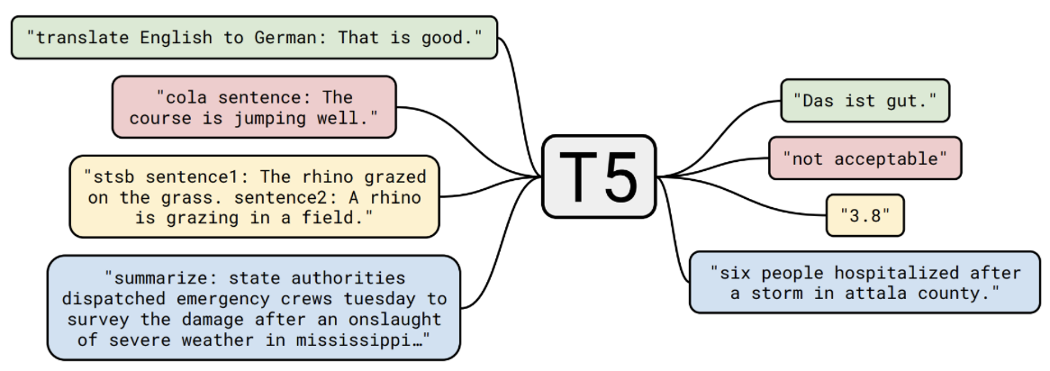
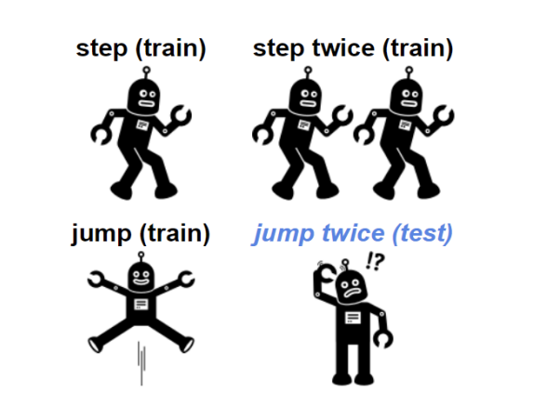
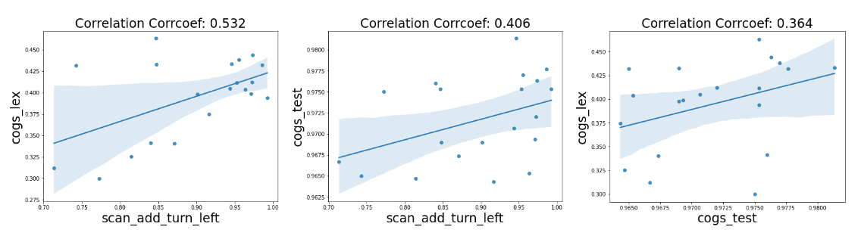
Correlation Analysis on Generalization Capacities
of Different Compositional Problems
Group Members: Yoobin Cheong, Yeong Koh, Yoon Tae Park
Abstract
Methods and Models
Conclusions
There exist many benchmark tests that claim to evaluate the abstract capacity of compositional generalization.
To investigate whether these tests that fall under this abstraction target the same underlying capacity, we performed a correlation analysis on the performance of various neural network models trained on multiple tasks that have been proposed to measure compositional generalization.
Models/architectures used for training
We used a T5-small non-pretrained model, which is an encoder-decoder transformer architecture, to compare the Exact Match scores of different dataset/tasks after training. Our primary focus was to experiment with the different datasets rather than various models.
Each random state indicates a different initialization of the weights in each model, and we can find that different initializations affect the model’s performance; accuracies can vary in the range of <1% to ~20%.
Our results show that there are some highly correlated tasks both within the dataset and across different datasets. Our top 3 correlated tasks were 1) ‘COGS-lexical’ and ‘SCAN-add-turn-left’ (Correlation coefficient: 0.532), 2) ‘COGS-test’ and ‘SCAN-add-turn-left’ (Correlation coefficient: 0.406), and 3) ‘COGS-lexical’ and ‘COGS-test’ (Correlation coefficient: 0.364), indicating that the model shows a moderately correlated compositional generalization capacity.
However, for other pairs of tasks, such as the "SCAN-simple" and ‘SCAN-add-turn-left’ pair, the correlations were lower, indicating that even though the tasks are framed as compositional generalization tasks, they recruit different capacities, as doing well on one task doesn't entail doing well another task.
Note that the exact match score may not directly reflect the model’s accuracy as the exact match score is improved only when the two sequences are exactly matched. For example, a model that gets only one token wrong but everything else in the sequence correct would still get 0% accuracy although the loss for this model continuously improves over the course of training.
As a result, we found that there exist some tasks that have high correlations (i.e. SCAN turn left vs COGS lexical: 0.5, COGS test vs lexical: 0.4), indicating that there is a strong evidence of language models having compositional generalization capacities.
Baseline experiment :
SCAN-simple
SCAN-length SCAN-addprim turn left
CFQ
COGS
Default Parameters :
20 random seeds
batch size = 128
learning rate = 5e-05
Epoch = 200
Correlation Plots between datasets
(Evaluation Metric: Exact Match)
Compositional Generalization illustration (Li et al., 2019)
Background
Research Question: Does good performance on task X generally entail good performance on task Y as well?
Introduction
There exist many benchmark tests that claim to evaluate the abstract capacity of compositional generalization. To investigate whether these tests that fall under this abstraction target the same underlying capacity, we performed a correlation analysis on the performance of various neural network models trained on multiple tasks that have been proposed to measure compositional generalization. As a potential outcome of our project, grouping of tasks that are identified as being highly correlated will provide insights towards a better characterization of the abstraction compositional generalization, and furthermore be useful for task selection in multitask learning or transfer learning.
Dataset
Various datasets constructed to test compositional generalization tasks: SCAN, CFQ, COGS, PCFG SET, SMCalFlow
Results
Top Correlation tasks: This figure shows top correlated tasks pairs. Although the datasets were trained using different methods, high correlations across some of the datasets were observed.
Acknowledgement
We would like to thank Najoung Kim, Faculty Fellow at CDS, New York University for her constructive feedback and all her suggestions. This project is a part of her ongoing research project.
Overall Correlation:
This table shows overall correlation among each task pairs. We can see some tasks pairs showing high correlations (>= 0.30)
Dataset-Task |  | SCAN |  |  | CFQ | COGS
 |  | Simple | Length | Turnleft | MCD1 | Test | Lexical | Structural
SCAN | Simple | 1.000 | 0.081 | 0.002 | -0.029 | -0.094 | -0.219 | 0.194
 | Length | 0.081 | 1.000 | 0.269 | -0.036 | 0.337 | -0.352 | 0.045
 | Turnleft | 0.002 | 0.269 | 1.000 | 0.051 | 0.406 | 0.532 | 0.141
CFQ | MCD1 | -0.029 | -0.036 | 0.051 | 1.000 | -0.144 | 0.083 | 0.188
COGS | Test | -0.094 | 0.337 | 0.406 | -0.144 | 1.000 | 0.364 | 0.105
 | Lexical | -0.219 | -0.352 | 0.532 | 0.083 | 0.364 | 1.000 | 0.065
 | Structural | 0.194 | 0.045 | 0.141 | 0.188 | 0.105 | 0.065 | 1.000
References
Vamsi Aribandi, Yi Tay, Tal Schuster, Jinfeng Rao, Huaixiu Steven Zheng, Sanket Vaibhav Mehta, Hon-glei Zhuang, Vinh Q. Tran, Dara Bahri, Jianmo Ni, Jai Gupta, Kai Hui, Sebastian Ruder, and Donald Metzler. 2021. Ext5: Towards extreme multi-task scaling for transfer learning.
Daniel Furrer, Marc van Zee, Nathan Scales, and Nathanael Scha ̈rli. 2020. Compositional generalization in semantic parsing: Pre-training vs. specialized architectures.
Dieuwke Hupkes, Verna Dankers, Mathijs Mul, and Elia Bruni. 2019. Compositionality decomposed: how do neural networks generalise?
Daniel Keysers, Nathanael Scha ̈rli, Nathan Scales, Hylke Buisman, Daniel Furrer, Sergii Kashubin, Nikola Momchev, Danila Sinopalnikov, Lukasz Stafiniak, Tibor Tihon, Dmitry Tsarkov, Xiao Wang, Marc van Zee, and Olivier Bousquet. 2019. Measuring compositional generalization: A comprehensive method on realistic data.
Najoung Kim and Tal Linzen. 2020. Cogs: A compositional generalization challenge based on semantic interpretation.
Brenden Lake and Marco Baroni. 2018. Generalization without systematicity: On the compositional skills of sequence-to-sequence recurrent networks. In Proceedings of the 35th International Conference on Machine Learning, volume 80 of Proceedings of Machine Learning Research, pages 2873–2882. PMLR.
Mike Lewis, Yinhan Liu, Naman Goyal, Marjan Ghazvininejad, Abdelrahman Mohamed, Omer Levy, Ves Stoyanov, and Luke Zettlemoyer. 2019. Bart: Denoising sequence-to-sequence pre-training for natural language generation, translation, and comprehension.
Yuanpeng Li, Liang Zhao, Jianyu Wang, and Joel Hestness. 2019. Compositional generalization for primitive substitutions.
Linqing Liu, Patrick Lewis, Sebastian Riedel, and Pon- tus Stenetorp. 2021. Challenges in generalization in open domain question answering.
Colin Raffel, Noam Shazeer, Adam Roberts, Katherine Lee, Sharan Narang, Michael Matena, Yanqi Zhou, Wei Li, and Peter J. Liu. 2019. Exploring the limits of transfer learning with a unified text-to-text transformer.
Pia Weißenhorn, Yuekun Yao, Lucia Donatelli, and Alexander Koller. 2022. Compositional generalization requires compositional parsers.

Slide 2
Correlation Analysis on Generalization Capacities
of Different Compositional Problems
Group Members: Yoobin Cheong, Yeong Koh, Yoon Tae Park
Abstract
Methods and Models
Conclusions
There exist many benchmark tests that claim to evaluate the abstract capacity of compositional generalization.
To investigate whether these tests that fall under this abstraction target the same underlying capacity, we performed a correlation analysis on the performance of various neural network models trained on multiple tasks that have been proposed to measure compositional generalization.
Models/architectures used for training
We used a T5-small non-pretrained model, which is an encoder-decoder transformer architecture, to compare the Exact Match scores of different dataset/tasks after training. Our primary focus was to experiment with the different datasets rather than various models.
Each random state indicates a different initialization of the weights in each model, and we can find that different initializations affect the model’s performance; accuracies can vary in the range of <1% to ~20%.
Our results show that there are some highly correlated tasks both within the dataset and across different datasets. Our top 3 correlated tasks were 1) ‘COGS-lexical’ and ‘SCAN-add-turn-left’ (Correlation coefficient: 0.532), 2) ‘COGS-test’ and ‘SCAN-add-turn-left’ (Correlation coefficient: 0.406), and 3) ‘COGS-lexical’ and ‘COGS-test’ (Correlation coefficient: 0.364), indicating that the model shows a moderately correlated compositional generalization capacity.
However, for other pairs of tasks, such as the "SCAN-simple" and ‘SCAN-add-turn-left’ pair, the correlations were lower, indicating that even though the tasks are framed as compositional generalization tasks, they recruit different capacities, as doing well on one task doesn't entail doing well another task.
Note that the exact match score may not directly reflect the model’s accuracy as the exact match score is improved only when the two sequences are exactly matched. For example, a model that gets only one token wrong but everything else in the sequence correct would still get 0% accuracy although the loss for this model continuously improves over the course of training.
As a result, we found that there exist some tasks that have high correlations (i.e. SCAN turn left vs COGS lexical: 0.5, COGS test vs lexical: 0.4), indicating that there is a strong evidence of language models having compositional generalization capacities.
Experimental setup / Scope of the experiment
As a baseline experiment, we selected SCAN "simple", "length", and "addprim turn left" dataset/tasks to compute correlations and then expanded our experiment to other datasets, CFQ and COGS. To enhance consistency of each experiment, we tested different weight instantiations for each model using 20 random seeds. We used 128 batch size, 5e-05 learning rate, and 200 epochs as our default parameter settings. In the case that we encountered unexpectedly low performances on certain tasks, we performed further hyperparameter tuning.
Evaluation method
Exact Match was used as our metric to keep track of the model performance for different random seeds. As we focused more on the variance in the model performances, we’ve checked whether the exact match score of our models generally aligns with the results from the literature, as a minimum threshold.
Compositional Generalization illustration (Li et al., 2019)
Background
Research Question: Does good performance on task X generally entail good performance on task Y as well?
Introduction
There exist many benchmark tests that claim to evaluate the abstract capacity of compositional generalization. To investigate whether these tests that fall under this abstraction target the same underlying capacity, we performed a correlation analysis on the performance of various neural network models trained on multiple tasks that have been proposed to measure compositional generalization. As a potential outcome of our project, grouping of tasks that are identified as being highly correlated will provide insights towards a better characterization of the abstraction compositional generalization, and furthermore be useful for task selection in multitask learning or transfer learning.
Dataset
Various datasets constructed to test compositional generalization tasks: SCAN, CFQ, COGS, PCFG SET, SMCalFlow
Results
Top Correlation tasks: This figure shows top correlated tasks pairs. Although the datasets were trained using different methods, high correlations across some of the datasets were observed.
Acknowledgement
We would like to thank Najoung Kim, Faculty Fellow at CDS, New York University for her constructive feedback and all her suggestions. This project is a part of her ongoing research project.
Overall Correlation:
This table shows overall correlation among each task pairs. We can see some tasks pairs showing high correlations (>= 0.30)
Dataset-Task |  | SCAN |  |  | CFQ | COGS
 |  | Simple | Length | Turnleft | MCD1 | Test | Lexical | Structural
SCAN | Simple | 1.000 | 0.081 | 0.002 | -0.029 | -0.094 | -0.219 | 0.194
 | Length | 0.081 | 1.000 | 0.269 | -0.036 | 0.337 | -0.352 | 0.045
 | Turnleft | 0.002 | 0.269 | 1.000 | 0.051 | 0.406 | 0.532 | 0.141
CFQ | MCD1 | -0.029 | -0.036 | 0.051 | 1.000 | -0.144 | 0.083 | 0.188
COGS | Test | -0.094 | 0.337 | 0.406 | -0.144 | 1.000 | 0.364 | 0.105
 | Lexical | -0.219 | -0.352 | 0.532 | 0.083 | 0.364 | 1.000 | 0.065
 | Structural | 0.194 | 0.045 | 0.141 | 0.188 | 0.105 | 0.065 | 1.000
References
Vamsi Aribandi, Yi Tay, Tal Schuster, Jinfeng Rao, Huaixiu Steven Zheng, Sanket Vaibhav Mehta, Hon-glei Zhuang, Vinh Q. Tran, Dara Bahri, Jianmo Ni, Jai Gupta, Kai Hui, Sebastian Ruder, and Donald Metzler. 2021. Ext5: Towards extreme multi-task scaling for transfer learning.
Daniel Furrer, Marc van Zee, Nathan Scales, and Nathanael Scha ̈rli. 2020. Compositional generalization in semantic parsing: Pre-training vs. specialized architectures.
Dieuwke Hupkes, Verna Dankers, Mathijs Mul, and Elia Bruni. 2019. Compositionality decomposed: how do neural networks generalise?
Daniel Keysers, Nathanael Scha ̈rli, Nathan Scales, Hylke Buisman, Daniel Furrer, Sergii Kashubin, Nikola Momchev, Danila Sinopalnikov, Lukasz Stafiniak, Tibor Tihon, Dmitry Tsarkov, Xiao Wang, Marc van Zee, and Olivier Bousquet. 2019. Measuring compositional generalization: A comprehensive method on realistic data.
Najoung Kim and Tal Linzen. 2020. Cogs: A compositional generalization challenge based on semantic interpretation.
Brenden Lake and Marco Baroni. 2018. Generalization without systematicity: On the compositional skills of sequence-to-sequence recurrent networks. In Proceedings of the 35th International Conference on Machine Learning, volume 80 of Proceedings of Machine Learning Research, pages 2873–2882. PMLR.
Mike Lewis, Yinhan Liu, Naman Goyal, Marjan Ghazvininejad, Abdelrahman Mohamed, Omer Levy, Ves Stoyanov, and Luke Zettlemoyer. 2019. Bart: Denoising sequence-to-sequence pre-training for natural language generation, translation, and comprehension.
Yuanpeng Li, Liang Zhao, Jianyu Wang, and Joel Hestness. 2019. Compositional generalization for primitive substitutions.
Linqing Liu, Patrick Lewis, Sebastian Riedel, and Pon- tus Stenetorp. 2021. Challenges in generalization in open domain question answering.
Colin Raffel, Noam Shazeer, Adam Roberts, Katherine Lee, Sharan Narang, Michael Matena, Yanqi Zhou, Wei Li, and Peter J. Liu. 2019. Exploring the limits of transfer learning with a unified text-to-text transformer.
Pia Weißenhorn, Yuekun Yao, Lucia Donatelli, and Alexander Koller. 2022. Compositional generalization requires compositional parsers.

Slide 3
Correlation Analysis on Generalization Capacities
of Different Compositional Problems
Group Members: Yoobin Cheong, Yeong Koh, Yoon Tae Park
Abstract
Methods and Models
Conclusions
There exist many benchmark tests that claim to evaluate the abstract capacity of compositional generalization.
To investigate whether these tests that fall under this abstraction target the same underlying capacity, we performed a correlation analysis on the performance of various neural network models trained on multiple tasks that have been proposed to measure compositional generalization.
Models/architectures used for training
We used a T5-small non-pretrained model, which is an encoder-decoder transformer architecture, to compare the Exact Match scores of different dataset/tasks after training. Our primary focus was to first experiment with the different datasets rather than various models. However, our study can be applied to further explore other models, such as BART-base.
Experimental setup / Scope of the experiment
As a baseline experiment, we selected SCAN "simple", "length", and "addprim turn left" dataset/tasks to compute correlations and then expanded our experiment to other datasets, CFQ and COGS. To enhance consistency of each experiment, we tested different weight instantiations for each model using 20 random seeds. We used 128 batch size, 5e-05 learning rate, and 200 epochs as our default parameter settings. In the case that we encountered unexpectedly low performances on certain tasks, we performed further hyperparameter tuning.
Evaluation method
Exact Match was used as our metric to keep track of the model performance for different random seeds. As we focused more on the variance in the model performances, we’ve checked whether the exact match score of our models generally aligns with the results from the literature, as a minimum threshold.
Each random state indicates a different initialization of the weights in each model, and we can find that different initializations affect the model’s performance; accuracies can vary in the range of <1% to ~20%.
Our results show that there are some highly correlated tasks both within the dataset and across different datasets. Our top 3 correlated tasks were 1) ‘COGS-lexical’ and ‘SCAN-add-turn-left’ (Correlation coefficient: 0.532), 2) ‘COGS-test’ and ‘SCAN-add-turn-left’ (Correlation coefficient: 0.406), and 3) ‘COGS-lexical’ and ‘COGS-test’ (Correlation coefficient: 0.364), indicating that the model shows a moderately correlated compositional generalization capacity.
However, for other pairs of tasks, such as the "SCAN-simple" and ‘SCAN-add-turn-left’ pair, the correlations were lower, indicating that even though the tasks are framed as compositional generalization tasks, they recruit different capacities, as doing well on one task doesn't entail doing well another task.
Note that the exact match score may not directly reflect the model’s accuracy as the exact match score is improved only when the two sequences are exactly matched. For example, a model that gets only one token wrong but everything else in the sequence correct would still get 0% accuracy although the loss for this model continuously improves over the course of training.
As a result, we found that there exist some tasks that have high correlations (i.e. SCAN turn left vs COGS lexical: 0.5, COGS test vs lexical: 0.4), indicating that there is a strong evidence of language models having compositional generalization capacities
Compositional Generalization illustration (Li et al., 2019)
Background
Research Question: Does good performance on task X generally entail good performance on task Y as well?
Introduction
There exist many benchmark tests that claim to evaluate the abstract capacity of compositional generalization. To investigate whether these tests that fall under this abstraction target the same underlying capacity, we performed a correlation analysis on the performance of various neural network models trained on multiple tasks that have been proposed to measure compositional generalization. As a potential outcome of our project, grouping of tasks that are identified as being highly correlated will provide insights towards a better characterization of the abstraction compositional generalization, and furthermore be useful for task selection in multitask learning or transfer learning.
Dataset
Various datasets constructed to test compositional generalization tasks: SCAN, CFQ, COGS, PCFG SET, SMCalFlow
Results
Top Correlation tasks: This figure shows top correlated tasks pairs. Although the datasets were trained using different methods, high correlations across some of the datasets were observed.
Acknowledgement
We would like to thank Najoung Kim, Faculty Fellow at CDS, New York University for her constructive feedback and all her suggestions. This project is a part of her ongoing research project.
Overall Correlation:
This table shows overall correlation among each task pairs. We can see some tasks pairs showing high correlations (>= 0.30)
Dataset-Task |  | SCAN |  |  | CFQ | COGS
 |  | Simple | Length | Turnleft | MCD1 | Test | Lexical | Structural
SCAN | Simple | 1.000 | 0.081 | 0.002 | -0.029 | -0.094 | -0.219 | 0.194
 | Length | 0.081 | 1.000 | 0.269 | -0.036 | 0.337 | -0.352 | 0.045
 | Turnleft | 0.002 | 0.269 | 1.000 | 0.051 | 0.406 | 0.532 | 0.141
CFQ | MCD1 | -0.029 | -0.036 | 0.051 | 1.000 | -0.144 | 0.083 | 0.188
COGS | Test | -0.094 | 0.337 | 0.406 | -0.144 | 1.000 | 0.364 | 0.105
 | Lexical | -0.219 | -0.352 | 0.532 | 0.083 | 0.364 | 1.000 | 0.065
 | Structural | 0.194 | 0.045 | 0.141 | 0.188 | 0.105 | 0.065 | 1.000
References
Vamsi Aribandi, Yi Tay, Tal Schuster, Jinfeng Rao, Huaixiu Steven Zheng, Sanket Vaibhav Mehta, Hon-glei Zhuang, Vinh Q. Tran, Dara Bahri, Jianmo Ni, Jai Gupta, Kai Hui, Sebastian Ruder, and Donald Metzler. 2021. Ext5: Towards extreme multi-task scaling for transfer learning.
Daniel Furrer, Marc van Zee, Nathan Scales, and Nathanael Scha ̈rli. 2020. Compositional generalization in semantic parsing: Pre-training vs. specialized architectures.
Dieuwke Hupkes, Verna Dankers, Mathijs Mul, and Elia Bruni. 2019. Compositionality decomposed: how do neural networks generalise?
Daniel Keysers, Nathanael Scha ̈rli, Nathan Scales, Hylke Buisman, Daniel Furrer, Sergii Kashubin, Nikola Momchev, Danila Sinopalnikov, Lukasz Stafiniak, Tibor Tihon, Dmitry Tsarkov, Xiao Wang, Marc van Zee, and Olivier Bousquet. 2019. Measuring compositional generalization: A comprehensive method on realistic data.
Najoung Kim and Tal Linzen. 2020. Cogs: A compositional generalization challenge based on semantic interpretation.
Brenden Lake and Marco Baroni. 2018. Generalization without systematicity: On the compositional skills of sequence-to-sequence recurrent networks. In Proceedings of the 35th International Conference on Machine Learning, volume 80 of Proceedings of Machine Learning Research, pages 2873–2882. PMLR.
Mike Lewis, Yinhan Liu, Naman Goyal, Marjan Ghazvininejad, Abdelrahman Mohamed, Omer Levy, Ves Stoyanov, and Luke Zettlemoyer. 2019. Bart: Denoising sequence-to-sequence pre-training for natural language generation, translation, and comprehension.
Yuanpeng Li, Liang Zhao, Jianyu Wang, and Joel Hestness. 2019. Compositional generalization for primitive substitutions.
Linqing Liu, Patrick Lewis, Sebastian Riedel, and Pon- tus Stenetorp. 2021. Challenges in generalization in open domain question answering.
Colin Raffel, Noam Shazeer, Adam Roberts, Katherine Lee, Sharan Narang, Michael Matena, Yanqi Zhou, Wei Li, and Peter J. Liu. 2019. Exploring the limits of transfer learning with a unified text-to-text transformer.
Pia Weißenhorn, Yuekun Yao, Lucia Donatelli, and Alexander Koller. 2022. Compositional generalization requires compositional parsers.

Slide 4
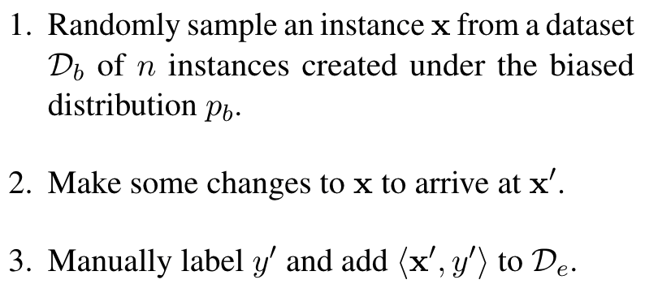

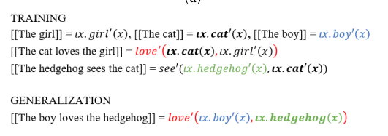
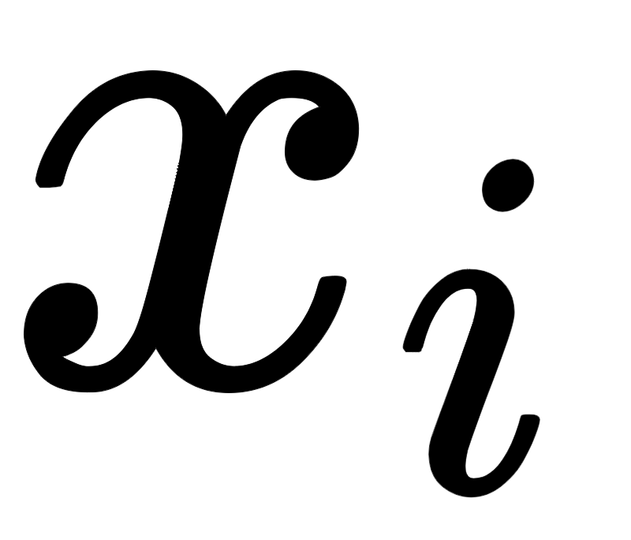

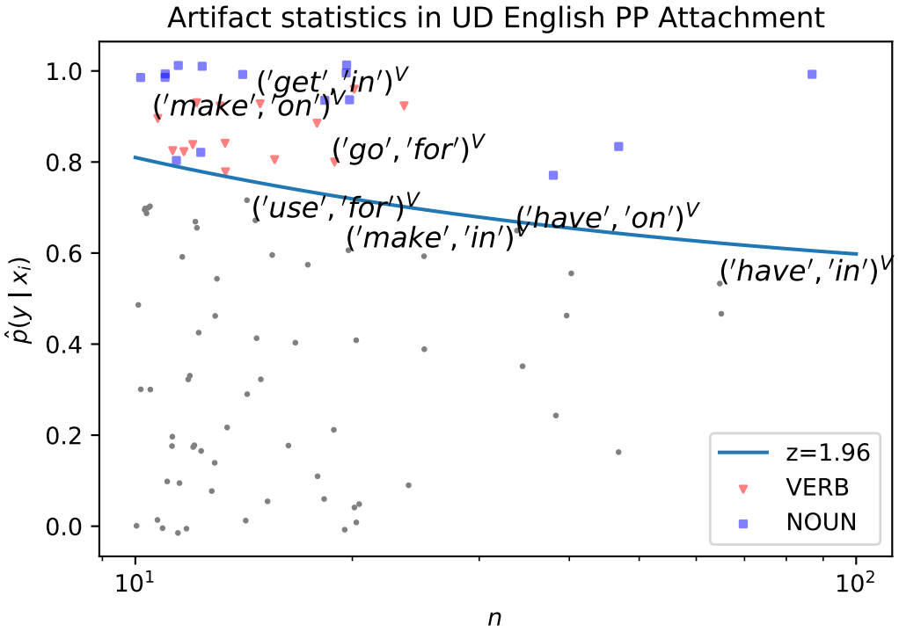
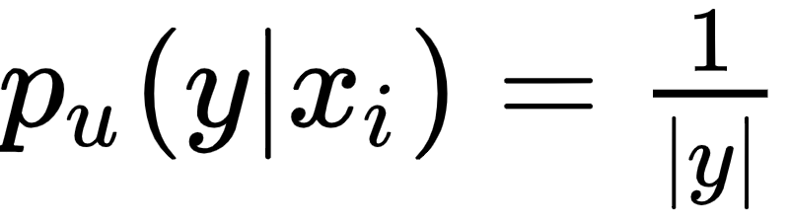
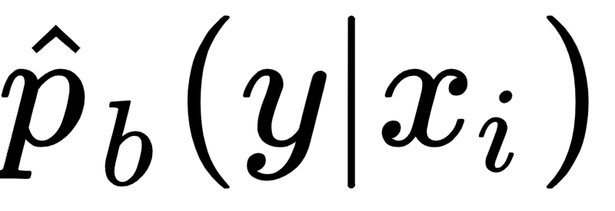
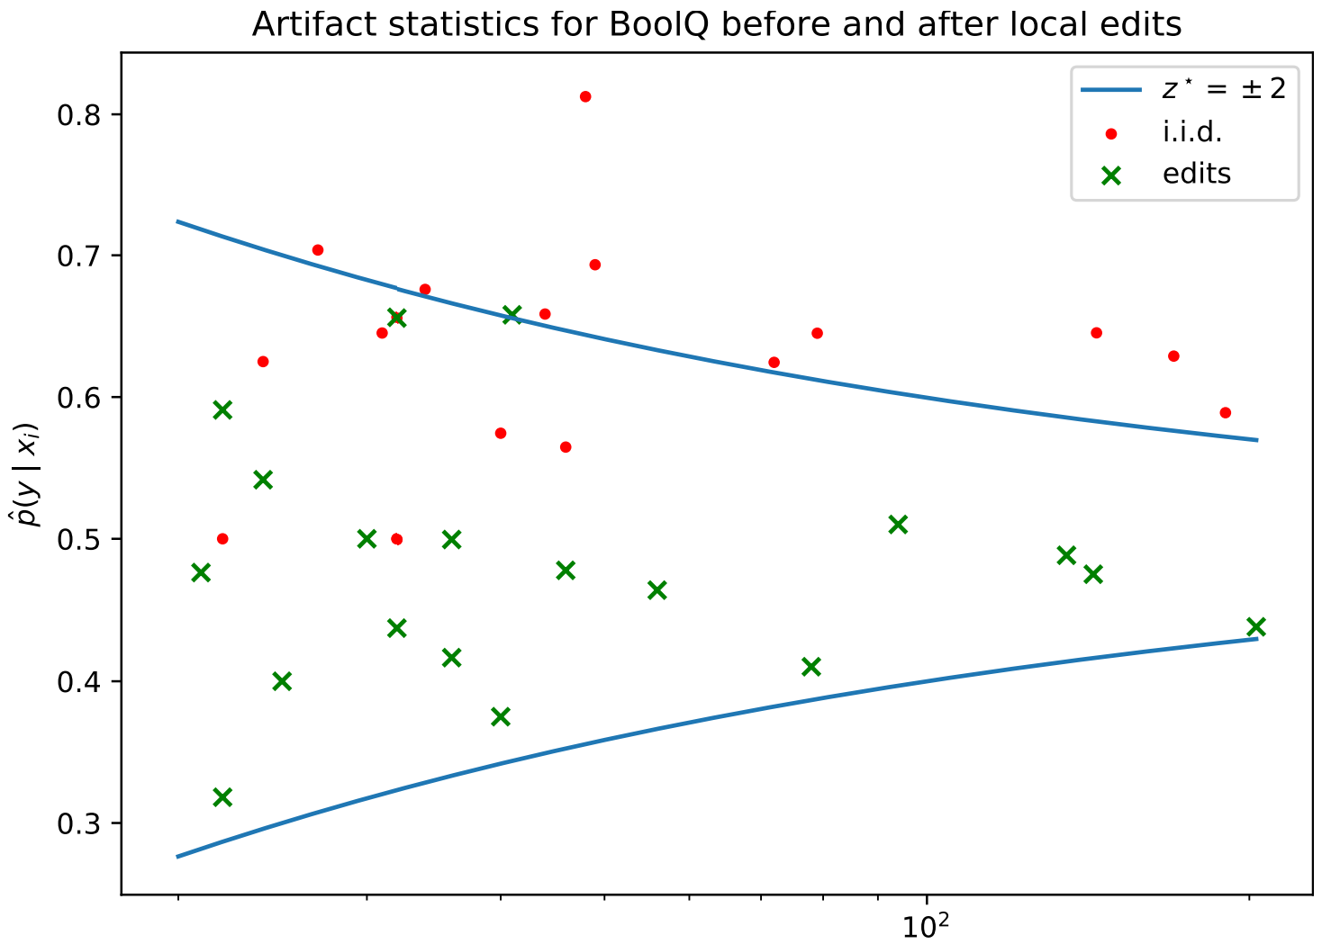
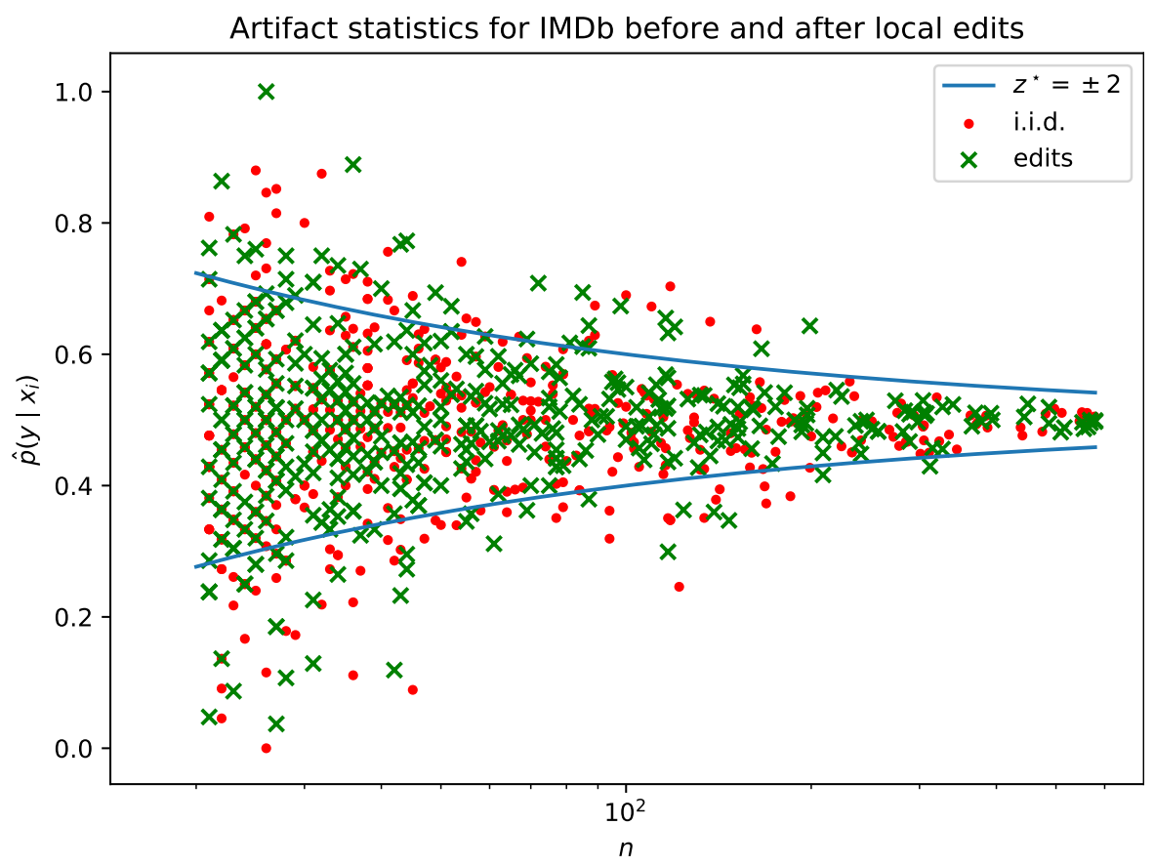
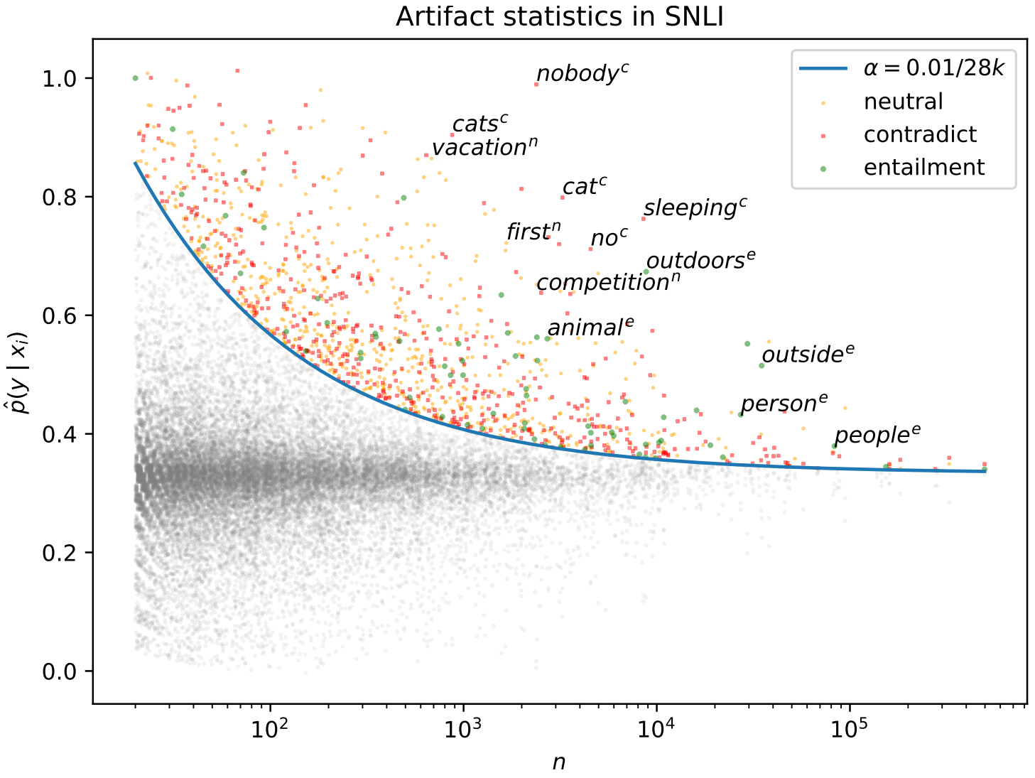


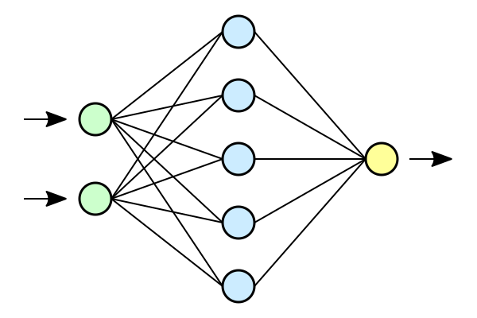
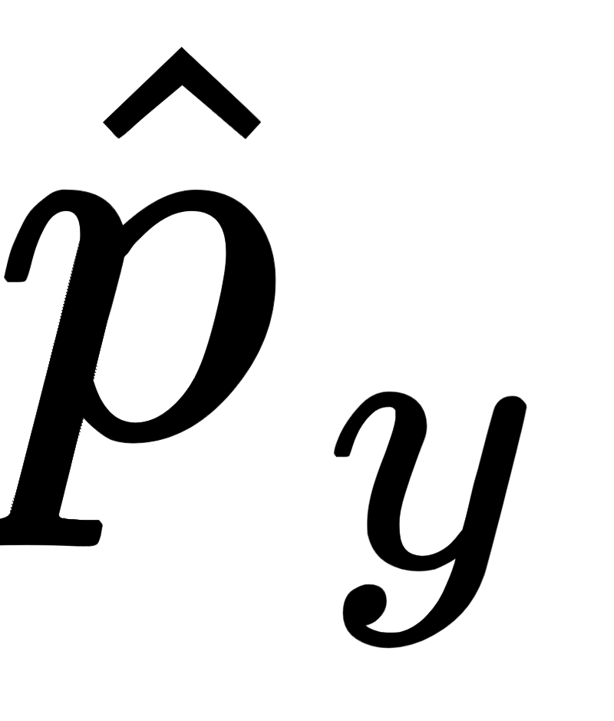
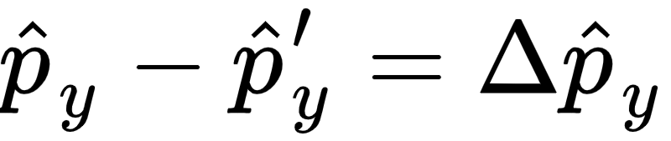
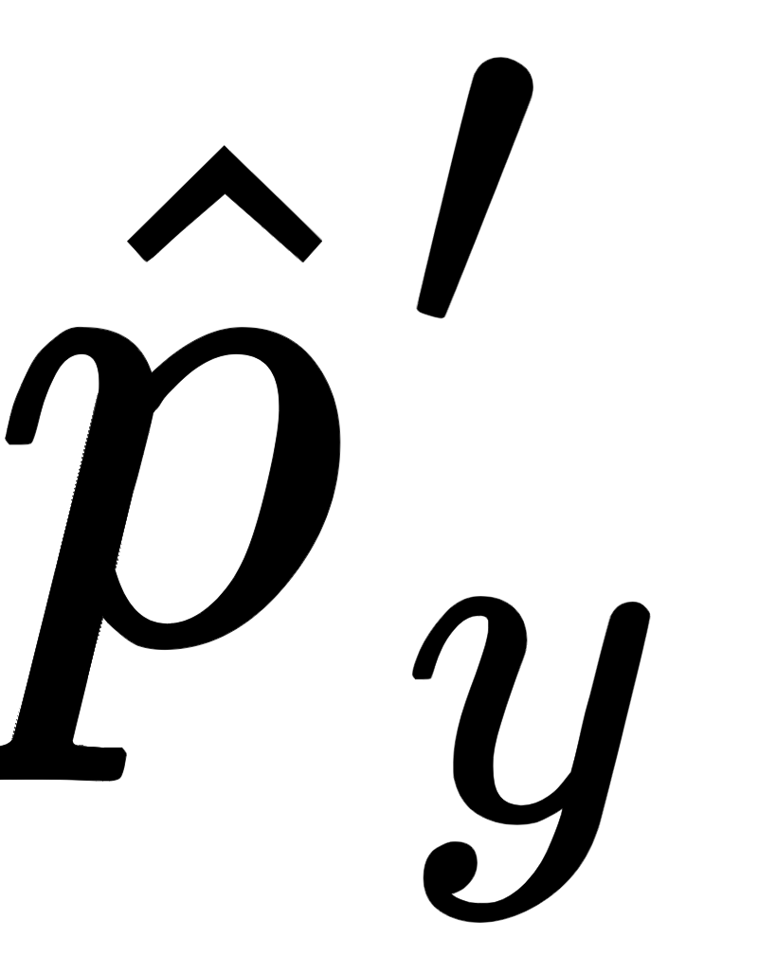
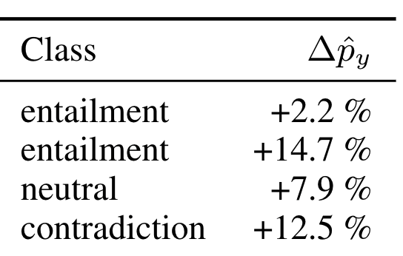
Correlation Analysis on Generalization Capacities
of Different Compositional Problems
There exist many benchmark tests that claim to evaluate the abstract capacity of compositional generalization.
To investigate whether these tests that fall under this abstraction target the same underlying capacity, we performed a correlation analysis on the performance of various neural network models trained on multiple tasks that have been proposed to measure compositional generalization.
Group Members: Yoobin Cheong, Yeong Koh, Yoon Tae Park
What are Compositional problems?
Q: Do Different Compositional Problems Rely on Similar Capacities?
A: For some tasks, yes. In general, need to investigate more
Removing competency artifacts
Local editing provably removes competency artifacts under certain conditions
"This movie is neither interesting nor fun."
Negative sentiment
Local editing:
“Edit and relabel”
Single features should not be informative about the label
Theorem: s = 0.5 ⇒ p_{e}(y’ | x_{i}’) = 0.5
Finding competency artifacts
s = probability that edit flips label (“edit sensitivity”)
In practice, local editing removes artifacts when ratio is right!
Competency problem: all simple correlations between input features and output labels are spurious, i.e.,
Which features violate competency assumption?
Ideal:
Can measure:
Important: task != dataset
Synthetic experiment: input a single token to trained model
Occurs more
w/ contradict
"nobody"
s = 0.52
s = 1.00
Real world data doesn’t reflect competency
But generalizing to competency setting is a necessary condition for NLU
Occurs less
w/ contradict
vs.
"outside"
Alternate (speculative) interpretation of local editing:
Evaluating using local edits measures sensitivity (Wegener, 1987) of learned function, unlike iid evaluation
Neural nets prefer low sensitivity (Franco, 2001); language is high-sensitivity (Hahn et al., 2021; also at EMNLP)
Thus, local edits can evaluate if neural net is making overly simple (=low sensitivity) generalization
(Section 5)
Models learn biases
∴ We argue competency is a good target for evaluating NLU systems

Slide 5
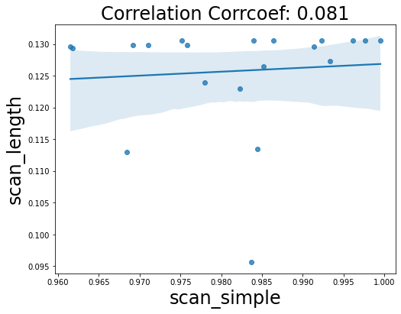
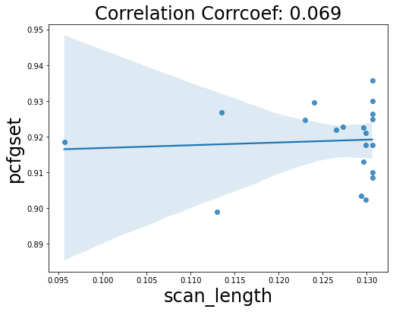
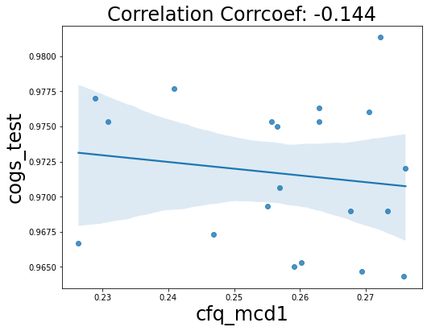
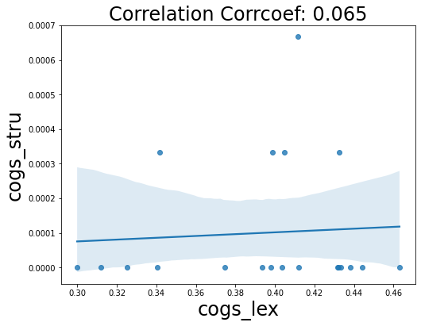
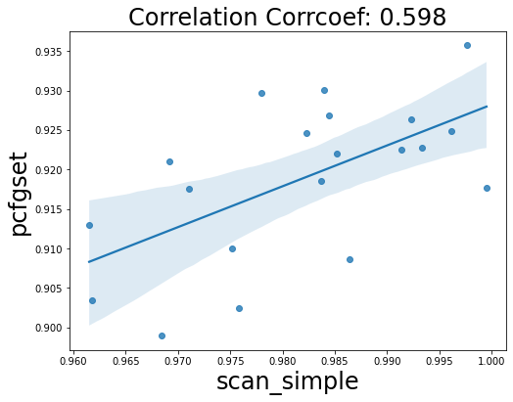
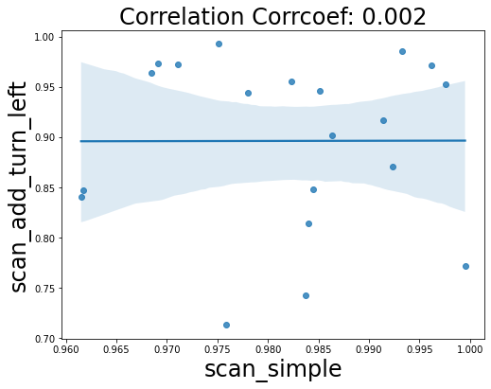
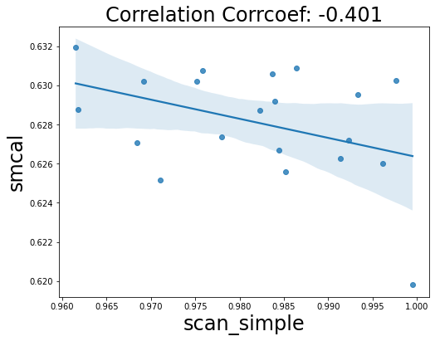
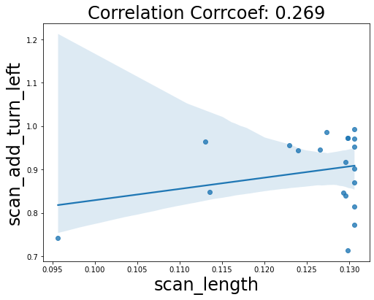
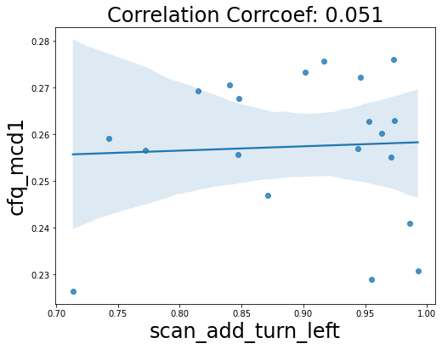

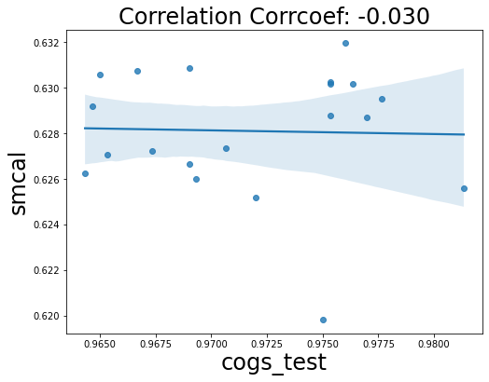
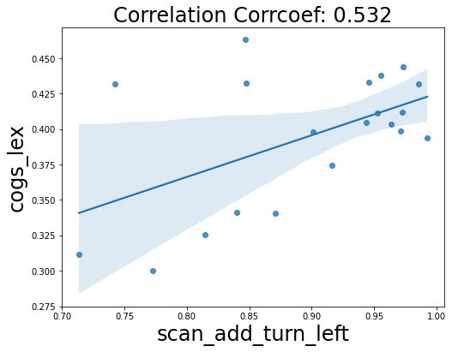
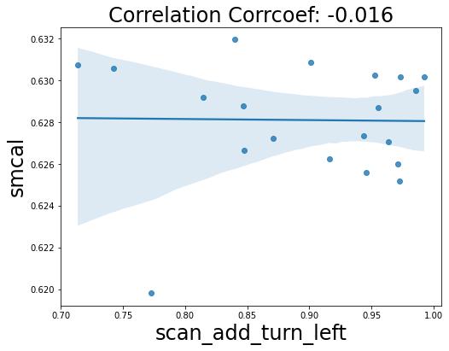
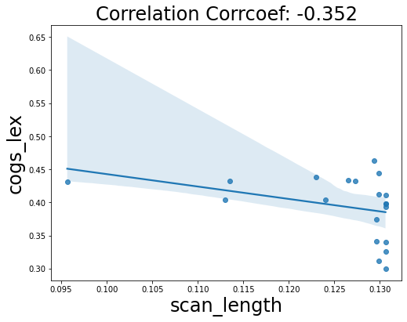
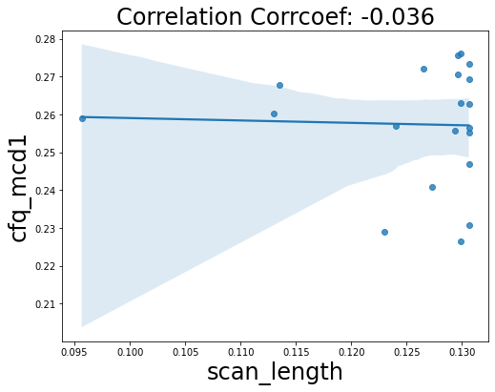
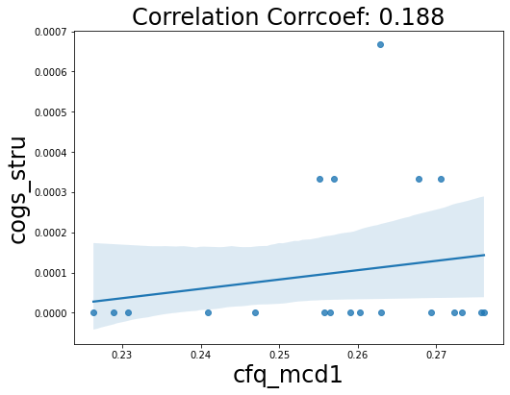
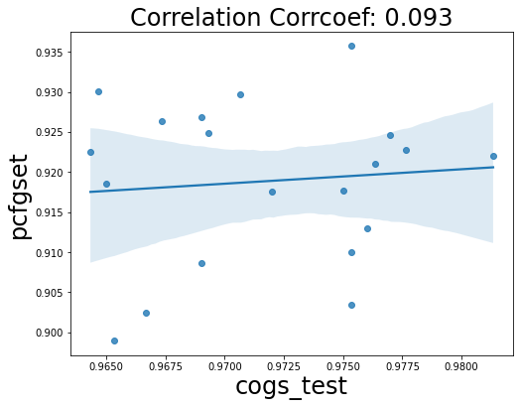
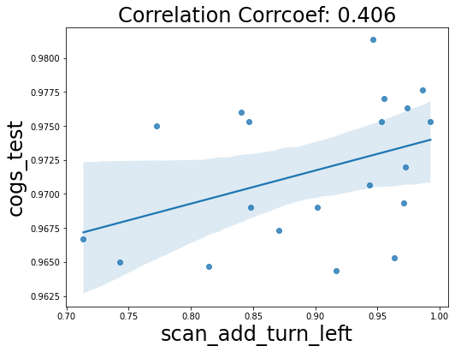

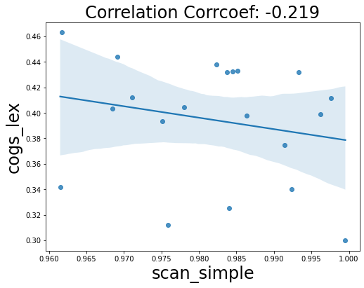
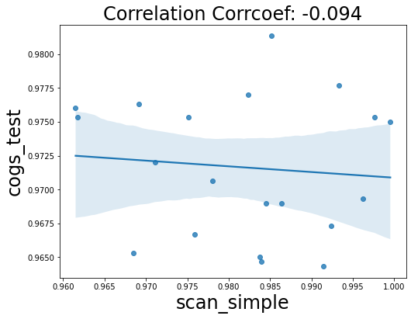
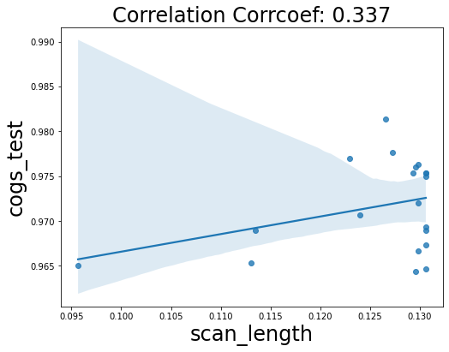
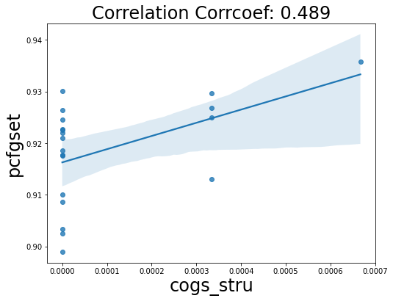
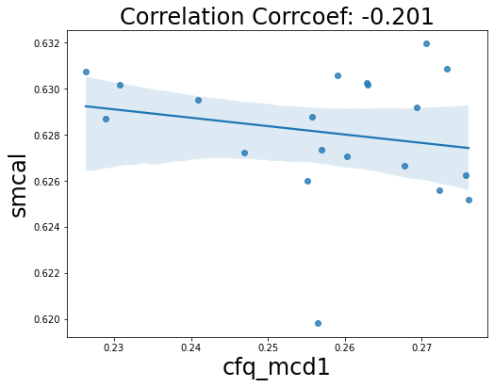
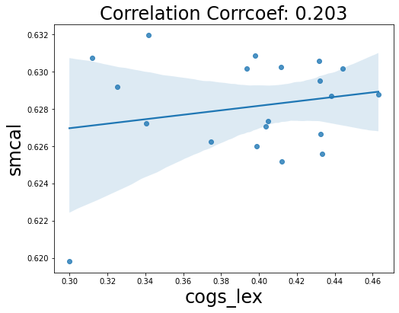
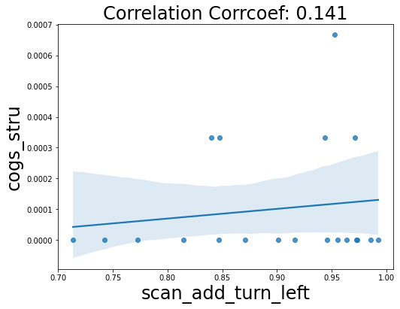
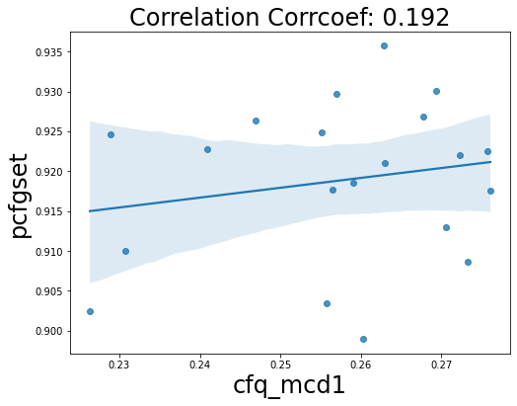
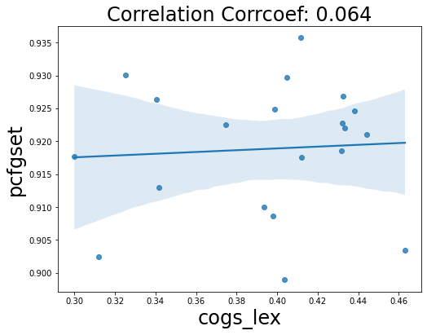
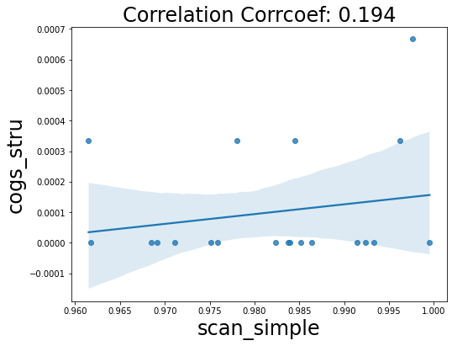
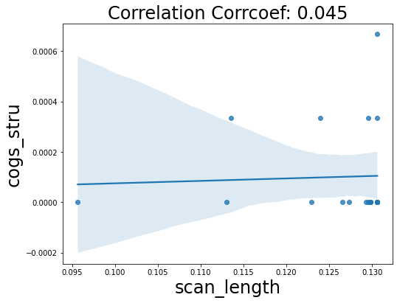
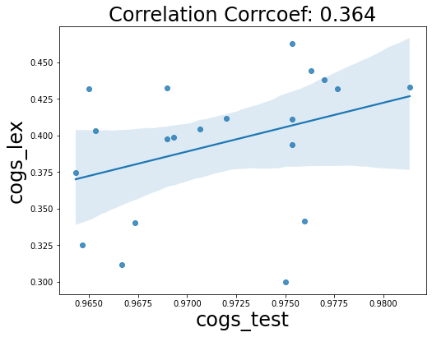
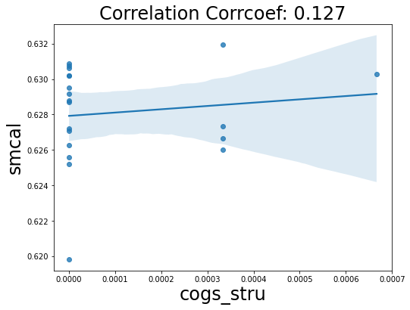
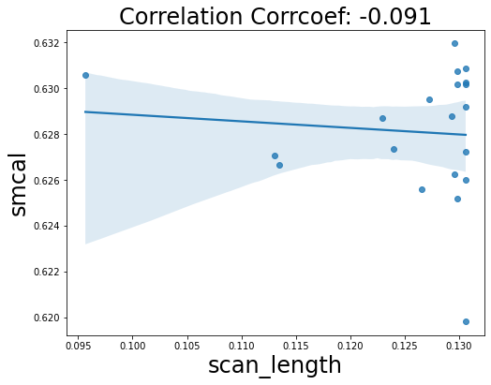
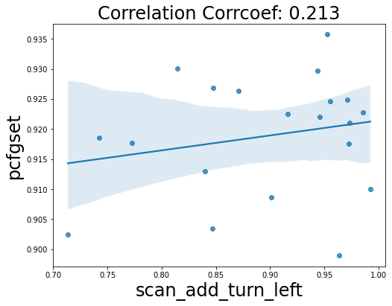
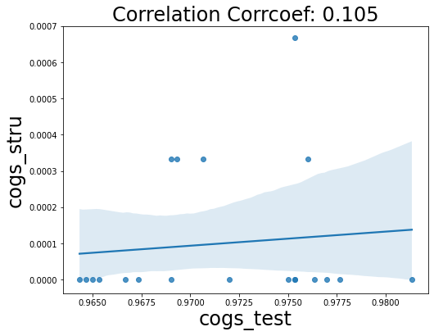


Slide 6
Correlation Analysis on Generalization Capacities
of Different Compositional Problems
Group Members: Yoobin Cheong, Yeong Koh, Yoon Tae Park
Q: Do Different Compositional Problems Rely
on Similar Capacities?
A: For some tasks, yes. In general, need to investigate more.
Results
What are Compositional problems?
We’ve conducted 36 experiments which consists of 9 different tasks with various datasets. The mean correlation across all pairs of tasks was 0.186. Below are the main findings.
Train smaller parts
that the data can be decomposed into
[The girl], [The cat], [The boy]
[The cat loves the girl]
[The hedgehog see the cat]
Experimental Design
[ Datasets with Relatively High Correlations ]
Dataset 1 | Dataset 2 | Correlation Coefficient
SCAN-simple | PCFGset | 0.598
SCAN-addprim turn left | COGS-lexical | 0.532
Dataset - Task
SCAN - simple
SCAN
Correlation
Analysis
Baseline Model
SCAN - length
CFQ
[Top3 Correlations on Positive, Neutral, and Negative]
COGS
SCAN - addprim turn left
SMCALFLOW
Exact Match
Score Evaluation
CFQ - mcd1
PCFGset
Pearson Correlation Coefficient
Generalize data
by combining known, smaller parts
[The boy loves the hedgehog]
T5-small
COGS - test
X 20 random seeds
COGS - lexical
batch size = 128
learning rate = 5e-05
epoch = 200
COGS - structural
SMCALFLOW
PCFGset
Why this matters? Compositional generalization capacity is often presented as a solution to generalize outside of the training data, but it is also considered that neural networks struggle to achieve
Step 1 Use different weight instantiations of the non-pretrained t5
model and calculate exact match score for 20 different
random seeds for given task
Step 2 Extend to other datasets that we defined and also calculate
exact match score
Main Goal: Experiment on multiple tasks to evaluate performance given different weight initializations, and conduct correlation analysis between different tasks to see that if there are any evidence of compositional generalization capacity
Conclusion
Step 3 Calculate Pearson Correlation Coefficient for all different
combination of task pairs
(X: selected task 1, Y: selected task 2, X != Y)
We’ve found that there were some highly correlated tasks, evidencing that those tasks would share similar compositional generalization capacities. We believe that further experimenting on those tasks will help to solve compositional problems that current SOTA transformer models struggle with.
𝔼[(𝐗 ౼ 𝜇_{𝑿})(𝐘 ౼ 𝜇_{𝒀})]
𝛒_{𝑿,𝒀} =
𝜎_{𝑿}𝜎_{𝒀}

